Slide 1
Development (housing) group
Housing assessment needs (provided by third party provider)
ready to be being kicked off
query with Horsham about methodology of their recommended provider (Now Resolved)
Notes:
L0148 – POOLED FUND Pitch Pack Library
SAVED: N:\Depts\Institutions\General\Financial Solutions\FSG market conditions pack

Slide 2
Development group Work to date
Call for sites
call for sites notice
drafted based on Cowfold example (MJ)
query over date to 2031
aware that call for sites should not only focus on housing (call for development sites of any kind)
relevant housing development is for 6 or more houses (less than this is dealt with in the normal manner via planning applications)
Notes:
2
2
2
L0148 – POOLED FUND Pitch Pack Library
SAVED: N:\Depts\Institutions\General\Financial Solutions\FSG market conditions pack

Slide 3
Development group Work to date
Call for Sites
agreed advertising of above to be
Your Steyning
posters in estate agents, newsagents and local notice boards
website
local newspaper (West Sussex County Times)
seeking costing of above advertising plans (MJ)
agreement to kick off call for sites asap.
call for sites will be open for six weeks (target end May to start July).

Slide 4
Development group Work to date
Call for sites will include summary description of sites
we felt there are two options for gathering more in depth data
ask land owner to fill as many data requirements as possible as required for suggested assessment criteria (development group to check and complete) / summary description sheets
housing group fill in data requirements for suggested assessment criteria / summary description sheets
we discussed the above and felt option 2 was most sensible to minimise any issues. We can ask the land owners for information as required.
Notes:
4
4
4
L0148 – POOLED FUND Pitch Pack Library
SAVED: N:\Depts\Institutions\General\Financial Solutions\FSG market conditions pack

Slide 5
Development group Work to date
Assessment of housing sites
we will have a target for housing which we will be trying to fulfil
there are suggested assessment criteria (see following pages) that we will complete. These will help us form initial recommendations
we will also fill out a site summary sheet (see following pages) .
we are unsure how long this part of the process might take – there will be engagement with SDNP and HDC on certain items
Assessment of other development sites
the group will consider these as/if the arise
the development group would liaise with the other steering groups to ensure consistency with wider plans

Slide 6
Development group Work to date
Engagement
we felt there were three options for gathering local opinion (or which we could do one, two or all)
initial questionnaire – difficult to know what to ask that would be helpful until we have the sites
engagement once we have proposed sites to inform our assessment and initial recommendations
engagement once we have made initial assessments and preliminary recommendations to ensure we are aligned with local opinion
we discussed the above and felt option 3 was most sensible.
we plan to have a local meeting where we display the initial assessments, site summary and preliminary recommendations (those that we plan to recommend for development and those that have been rejected as they failed to meet the criteria). We will collect feedback at this meeting. Copied of the initial assessments and preliminary recommendations will also be available on request for people unable to attend the meeting or who want more time to consider.
Notes:
6
6
6
L0148 – POOLED FUND Pitch Pack Library
SAVED: N:\Depts\Institutions\General\Financial Solutions\FSG market conditions pack

Slide 7
Development group Work to date
Advertising
agreed advertising for the above is proposed to be as follows
posters in estate agents, newsagents and local notice boards
website
we expect the majority of feedback will be from the meeting but we will probably also set a time limit of six weeks after the meeting date
other groups working on the Neighbourhood Plan may also want to use the meeting to gather feedback on wider proposals for environment, tourism, commerce, heritage, roads, bridleways & footpaths.

Slide 8
Development group Work to date
Immediate questions
do you agree with the proposals above ?
are there developments (other than housing) which you would like to see happening in Bramber ?

Slide 9
Example site assessment sheet
Notes:
9
9
9
L0148 – POOLED FUND Pitch Pack Library
SAVED: N:\Depts\Institutions\General\Financial Solutions\FSG market conditions pack

Slide 10
Example site assessment sheet
Notes:
10
10
10
L0148 – POOLED FUND Pitch Pack Library
SAVED: N:\Depts\Institutions\General\Financial Solutions\FSG market conditions pack

Slide 11
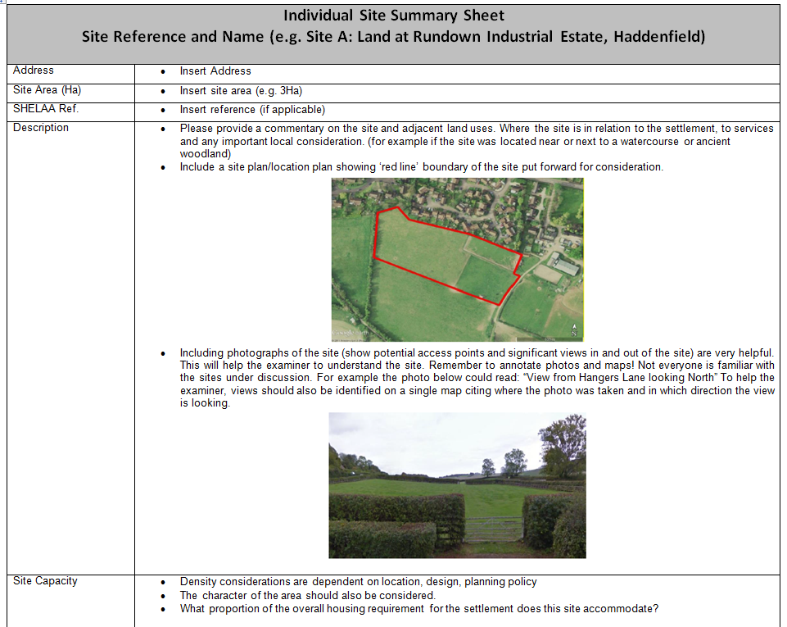
Example site summary sheet
Notes:
11
11
11
L0148 – POOLED FUND Pitch Pack Library
SAVED: N:\Depts\Institutions\General\Financial Solutions\FSG market conditions pack

Slide 12
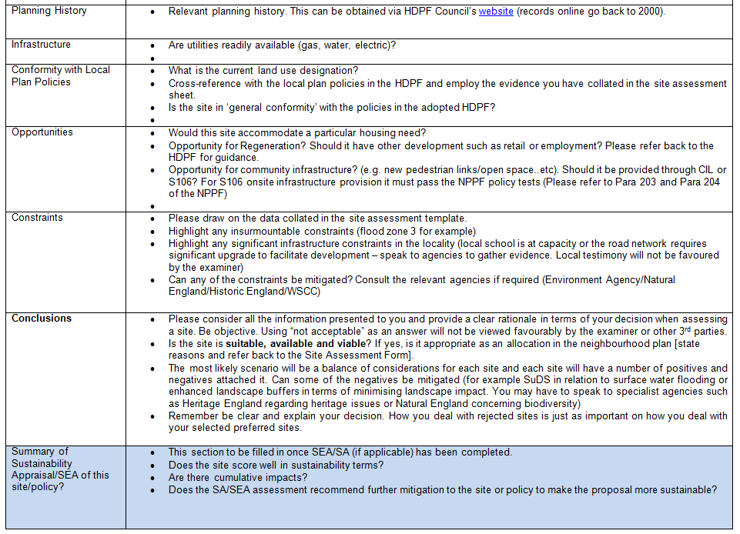
Example site summary sheet
Notes:
12
12
12
L0148 – POOLED FUND Pitch Pack Library
SAVED: N:\Depts\Institutions\General\Financial Solutions\FSG market conditions pack

Slide 13
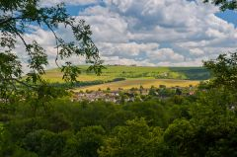

Slide 14
Environmental Focus Group
Parishioners
Environmental Focus Group
Green Spaces
Recommendations
Neighbourhood
Survey

Slide 15
SWOT Analysis
STRENGTHS
South Downs National Park
Footpaths & bridleways
Unspoilt countryside
Flora & fauna
etc.
WEAKNESSES
Footpath surfaces
Disability access
Connectivity
Parking
etc.
OPPORTUNITIES
Renewable energy
Education
Cycle paths
etc.
THREATS
Flooding
Invasive species
Inappropriate development
Noise & light pollution
etc.
(Typical Examples)

Slide 16
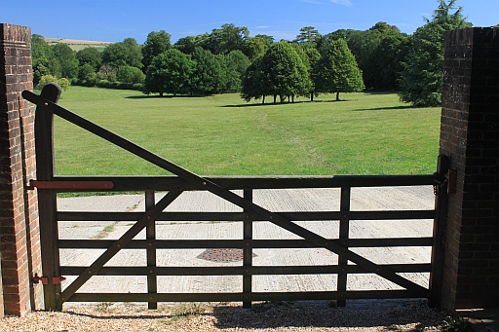
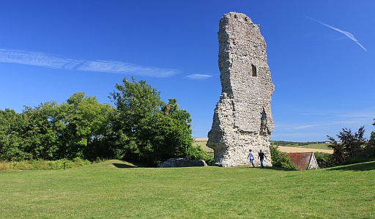
Green Spaces Report
Recreational
Value
Tranquillity
Wildlife
Value
Unprotected
Proximity
Beauty
Historical
Significance
Protected

Slide 17
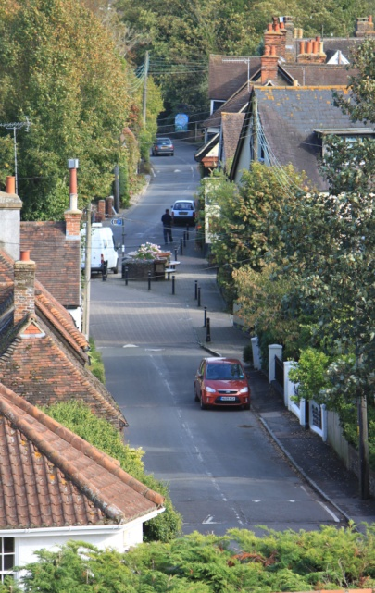
Focus Group Recommendations
Noise & Light
Pollution
Floodplains
Planning
Cyclists
Walkers
(Typical Examples)

Slide 18
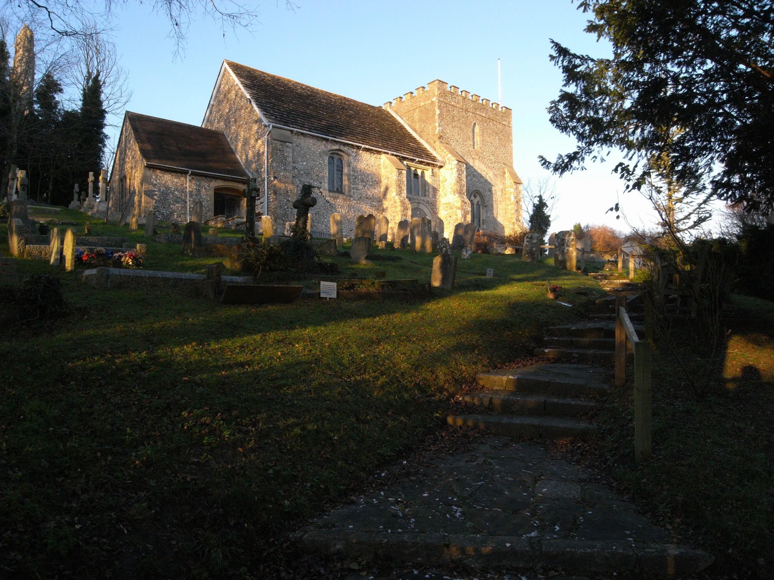
Heritage, Tourism and Commerce

Slide 19
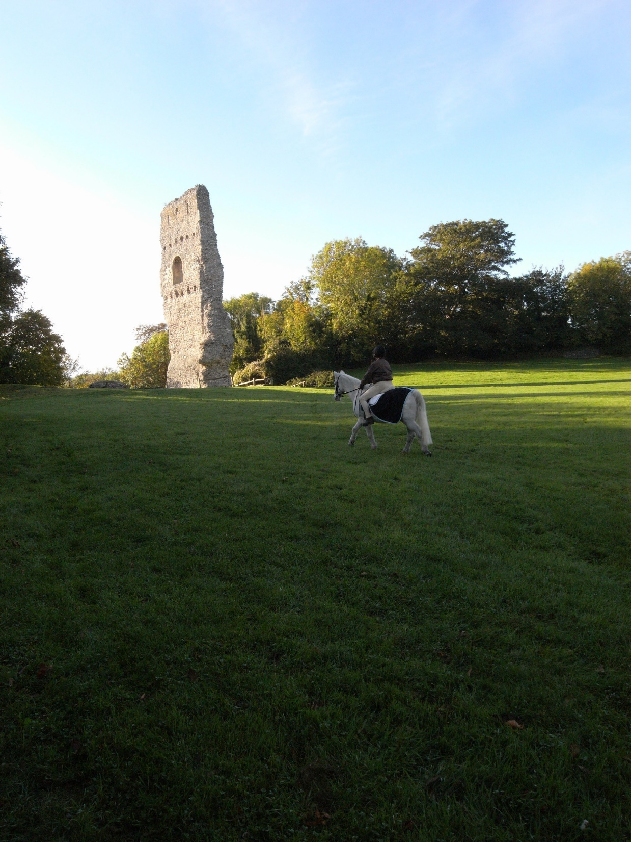
From Previous Research (for SWAB)
Important to protect both natural heritage and our historic built environment.
Opportunities to increase community and tourism use at the castle and St Nicholas Church.
Could support extensions to the hotel if viable.
Important to retain car park, toilets and bus shelter

Slide 20
Considerations for the Bramber Neighbourhood Plan
Heritage and Tourism
Potential for further use of St Nicholas and Botolphs Churches for community and cultural events
Further information about Bramber Castle could be made available and closer links forged with English Heritage.
An education centre at St Mary’s House could increase visitors and community engagement.
The new developments at Bramber Brooks could attract additional visitors to the area.

Slide 21
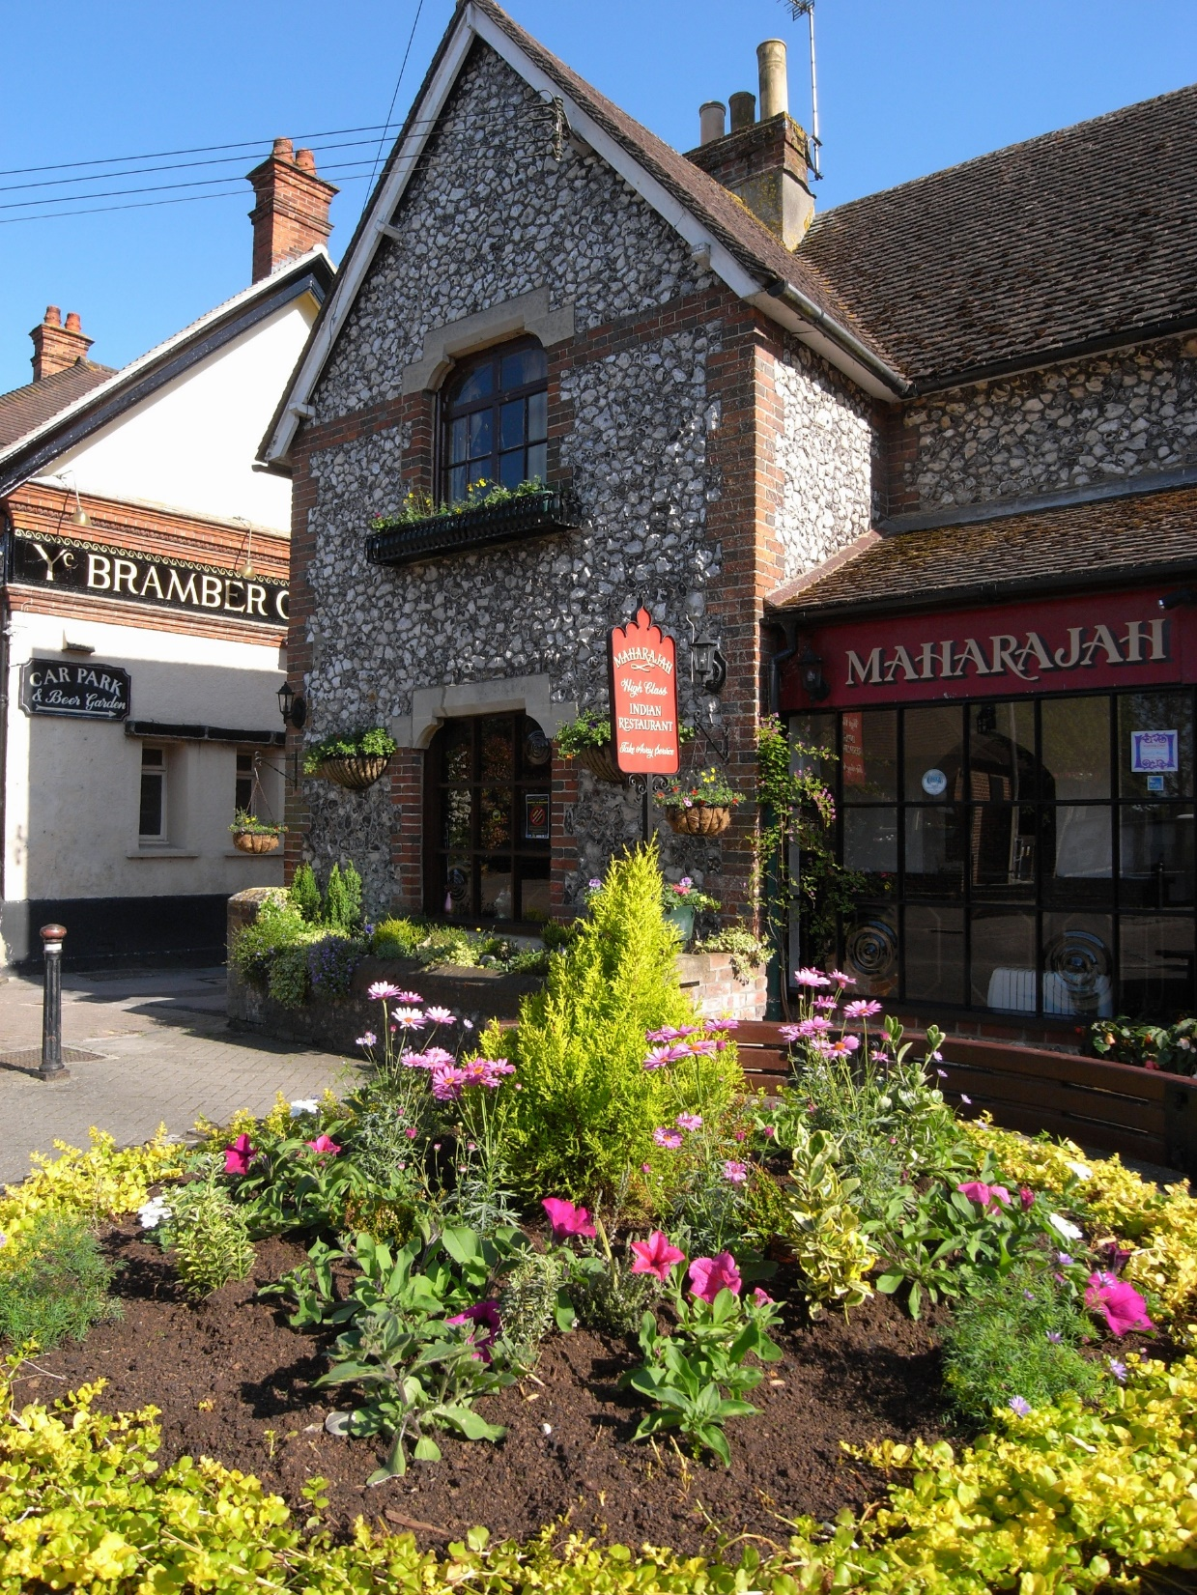
Considerations for the Bramber Neighbourhood Plan
Commerce
Areas to consider include:
The Old Tollgate Hotel and The Castle Inn and Hotel
The Indian and Chinese restaurants
Mobile trade (such as the coffee stand in the car park)
Annington Business Centre
Support for home workers
Other mobile and village based businesses (e.g. dog walkers, mobile hairdressers etc)
Botolphs cemetery

Slide 22
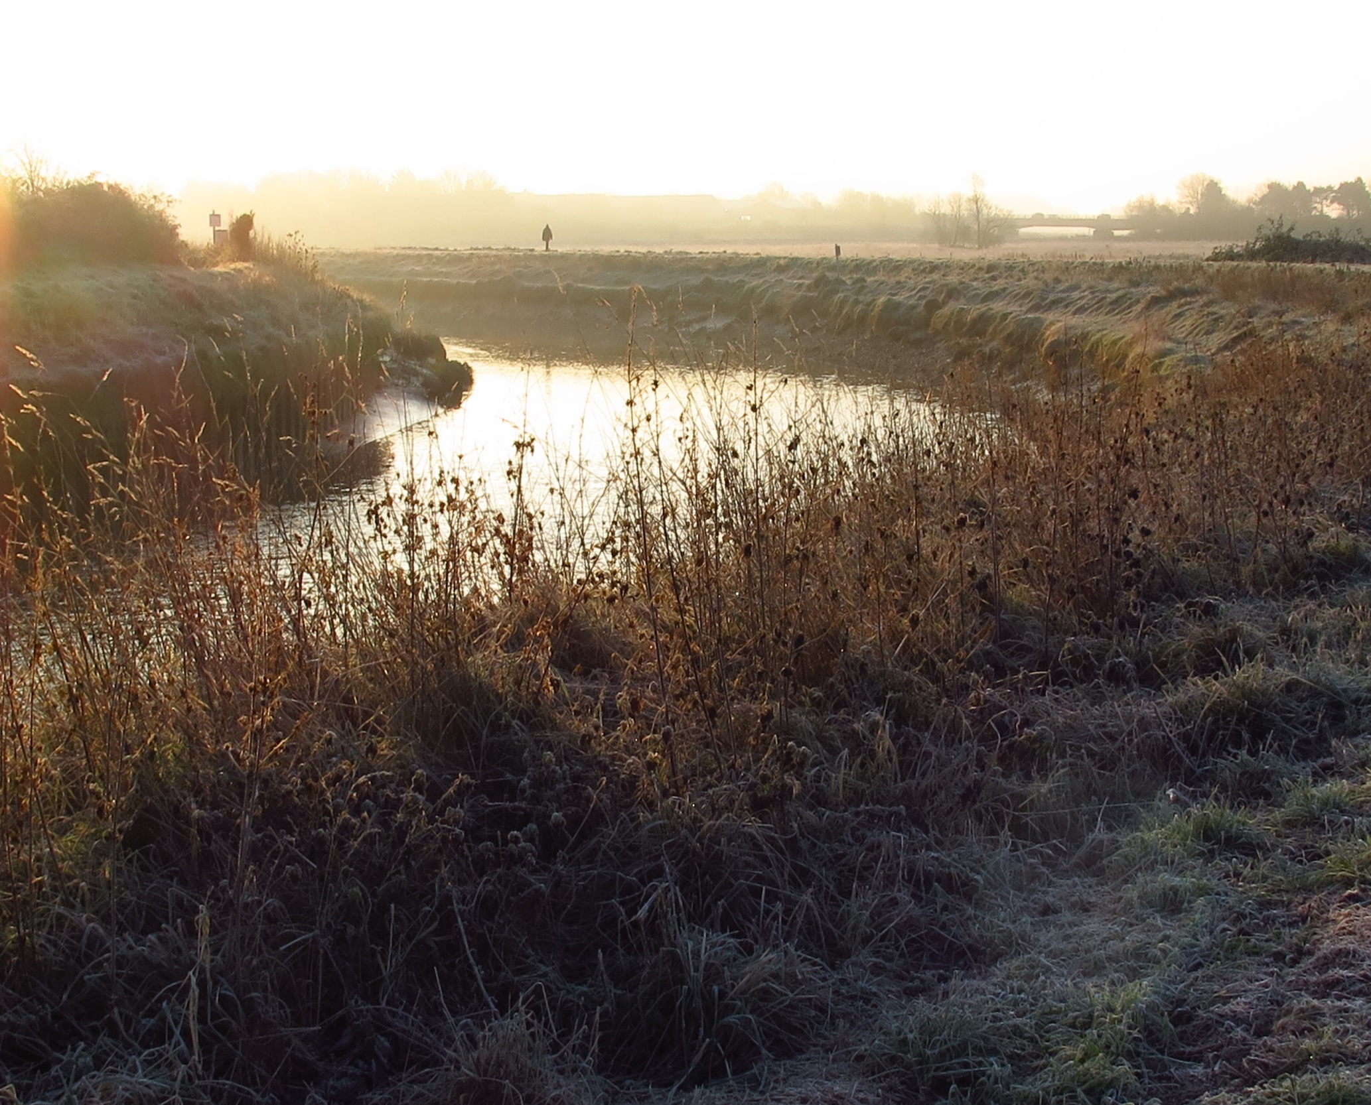
Next steps
Heritage, tourism and commerce questions in residents survey
Business survey
Consultation with residents and businesses

Slide 23
Neighbourhood Plan Transport and Accessibilty
Members:
Christine Supiot, Mike Croker
- neither of us are regular bus users
- additional volunteer(s) welcome!
Work to date:
SWAB work reviewed to extract Bramber info.

Slide 24
Neighbourhood Plan Transport and Accessibilty
Rights of Way (RoW)
Good number of public Rights of Way
- good local access
- 2 national trails:
- South Downs Way and Monarch’s Way
- share short distances on narrow roads
Provide good links for both recreational activities and non-motorised links to schools & work
Aim: it is important they are protected and maintained 'fit for purpose' in the plan

Slide 25
Neighbourhood Plan Transport and Accessibilty
Safe Routes to School and Work
Several important routes through the parish
Aim: these will need clear identification with help from schools, then protection / improvement

Slide 26
Neighbourhood Plan Transport and Accessibilty
Roads
Good links to the surrounding villages, towns, shops and services
Risk of increased traffic from proposed developments (local, cement works, Monks Farm)
Rural roads mostly narrow, derestricted, shared with a high volume of Non-Motorised Users (NMU) - increasing traffic, especially at peak times
Aim: surrounding road infrastructure must be integral with new development

Slide 27
Neighbourhood Plan Transport and Accessibilty
Parking
Not yet considered in detail
- insufficient parking for access to leisure trails?
Public Transport
Not yet considered in detail
- good number buses along Clays Hill & The Street
- poor services to Worthing hospital and colleges
- more direct service to Brighton required
Help needed with public transport section!

Slide 28
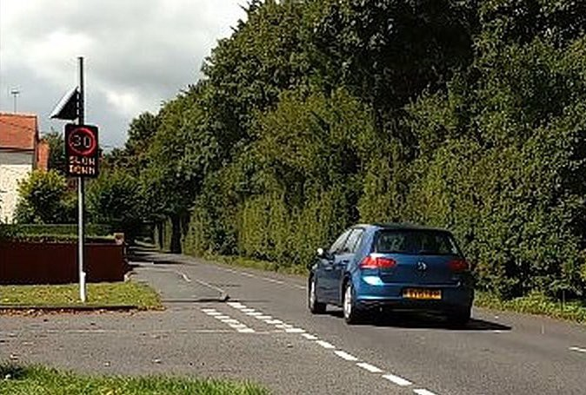
Vehicle Activated Speed Devices (VAS)
Two signs purchased and installed in 2017
Clays Hill
solar powered
fixed location
rotated every 2 months
records time/date/speed if > 33mph

Slide 29
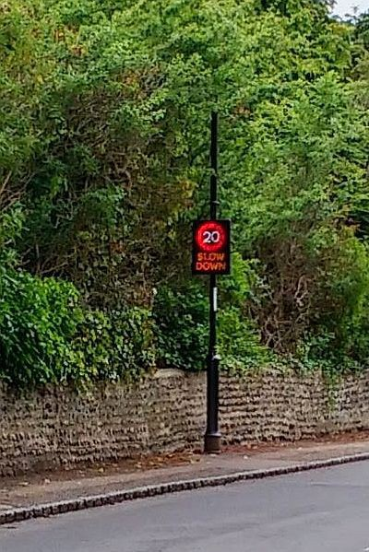
Vehicle Activated Speed Devices (VAS)
Two signs purchased and installed in 2017
Bramber / Upper Beeding
shared at 2 month intervals
easy to relocate
22 / 33 / 44 mph trigger
3 sites along The Street
battery powered
logs all traffic

Slide 30
Basic Statistics
Clays Hill: 20 to 25% of traffic exceeds 33 mph
Westbound:
~1500 per weekday speeding at 39 mph av.
Eastbound:
~1400 per weekday speeding at 37 mph av.
The Street
Westbound : 60% exceed 22 mph
~900 per weekday speeding at 24 mph av.
Eastbound : 30% exceed 22 mph
~600 per weekday speeding at 23 mph av.

Slide 31
Where now?
Clays Hill:
Work with neighbourhood wardens
- reporting to Operation Crackdown?
The Street
Assess 3rd location opposite The Tollgate

