Slide 1
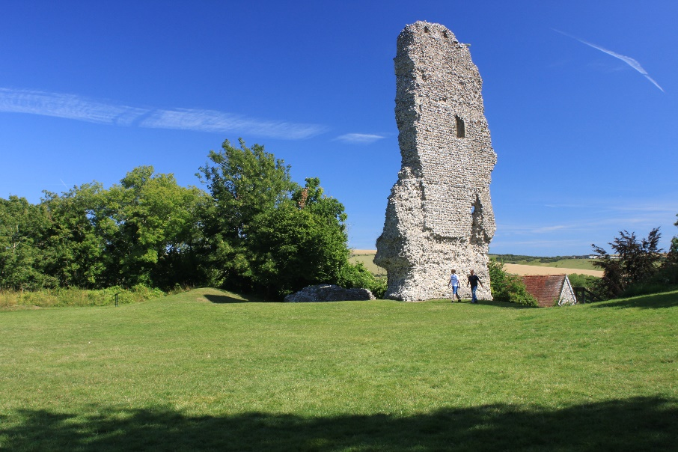
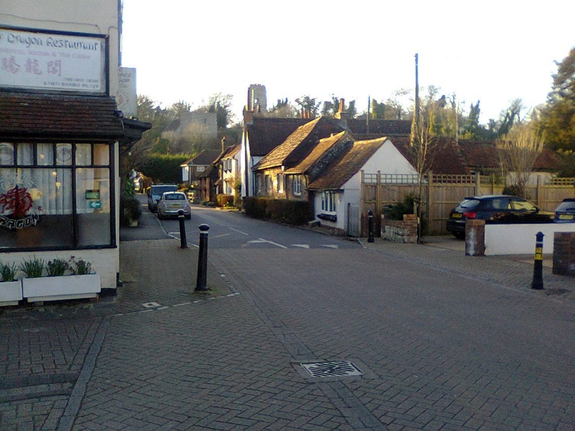
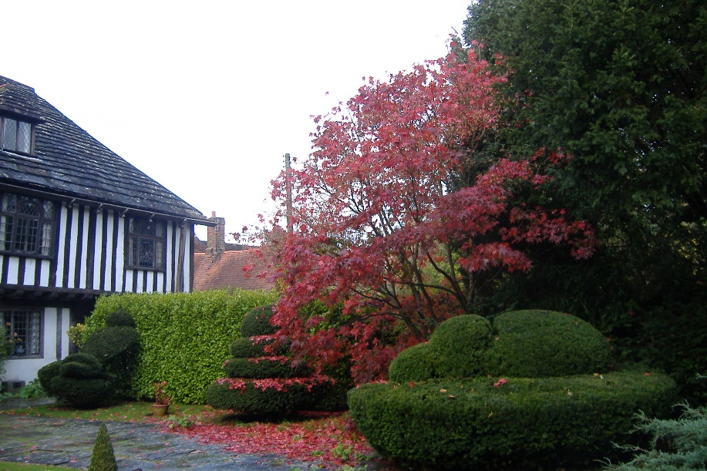
A Neighbourhood Plan for Bramber Parish

Slide 2
What is a Neighbourhood Plan?
Your opportunity to have a real say in how you want Bramber, the parish, to evolve over the next 15 to 20 years
You can use the Plan to set out:
What green spaces to protect
How to ensure that the right sort of homes are delivered, at the right scale and of the right design
How to protect Bramber’s character and heritage
Ways to encourage more walking and cycling
Improvements to assist local businesses
Priorities for community facilities
Ultimately your Plan will become part of the Local Plan – and planning applications will have to adhere to its policies, not just those set out by Horsham and the South Downs National Park.

Slide 3
The main steps involved…
Designate the Neighbourhood Area and assemble a team to lead the project
Gather facts and evidence – including from the local community – set out vision and objectives
Consider policies to address objectives including potential sites to deliver this
Engage on emerging options for inclusion in the Plan
The Plan is examined and will be the subject of a Public Referendum
Submit the Plan to Horsham District Council who will consult on it a second time
Amend the Plan bearing in mind comments from the local community
Draft the Plan and consult on it

Slide 4
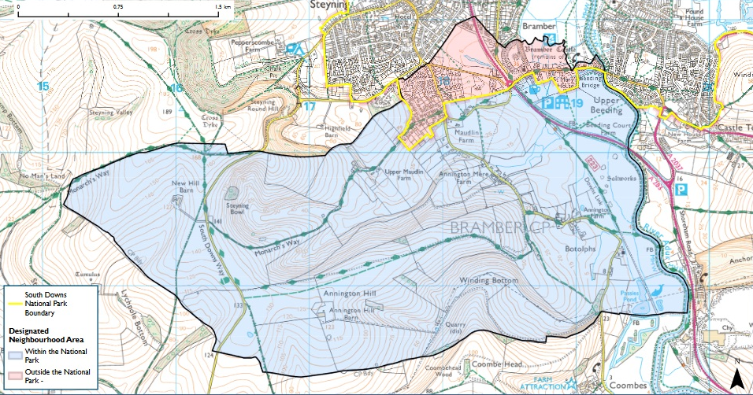
The Bramber Neighbourhood Plan covers the whole parish

Slide 5
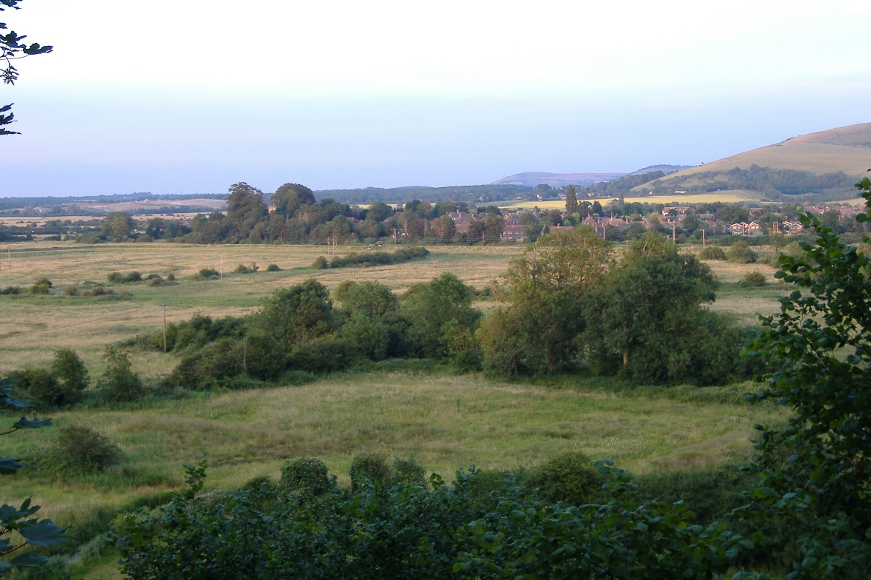
The purpose of today
To share the draft Vision and Objectives and emerging policy ideas
To capture your feedback on our progress so far
To ask specific questions to help shape some of the policy areas
To discuss local housing needs and how these might be delivered
To answer any questions you have

Slide 6
Some facts about neighbourhood planning
The Neighbourhood Plan is your opportunity to have a say in the way Bramber develops over the coming years
Without a neighbourhood plan, planning applications will be decided using the Horsham and South Downs Local Plans
The Neighbourhood Plan is not about preventing development; it’s about shaping development and getting the most out of it
We can use it to add local detail to the planning policies contained in the Horsham and the South Downs Local Plans
The Plan will go to a public referendum
Your views count – nothing is decided yet

